Slide 1
FOREST FIRE PREVENTION
Using Machine Learning
By Pranshul Sharma

Slide 2
INTRODUCTION
Forest fires, also known as wildfires, are uncontrolled fires that spread rapidly through combustible vegetation such as trees, shrubs, and grasses. These fires can vary in scale, from small bushfires to large forest fires, and pose a significant threat to both the environment and wildlife. Every year, forest fires result in extensive damage to ecosystems, leading to the destruction of flora and fauna, and contributing to the extinction of numerous wildlife species.

Slide 3
TABLE OF CONTENTS
01
02
SECTION
SECTION
03
04
SECTION
SECTION
Principle of Wildfire Detection
Alternatives
Development of ML Model
Future Versions

Slide 4
01
Principle of Wildfire Detection

Slide 5
3 IMPORTANT FACTORS
OXYGEN
TEMPERATURE
HUMIDITY

Slide 6
Principle of Wildfire detection
The detection of a wildfire primarily depends on three factors:
Oxygen Level: For any fire to occur, high oxygen content is required. The higher the oxygen level, the greater the probability of a wildfire occurring.
Temperature: High temperatures favor fire, so increased temperature raises the probability of fire in any region.
Humidity: Humid weather is unfavorable for fires, whereas dry weather is conducive to fires. Therefore, higher humidity lowers the probability of a fire occurring.

Slide 7
02
Alternatives & Their Drawbacks

Slide 8
Alternative Work
Camera Surveillance
Forest-Fire Reservoirs
Proposed System
This uses drones or camera equipment
Creating water supplies near forest areas
Using Machine Learning Algorithm

Slide 9
DRAWBACKS
Camera Surveillance: This approach uses drones or camera equipment to monitor forest areas for fires. However, detection can only be done once a fire has already started. Additionally, it is not economically feasible to cover large forest areas with cameras and drones. Forest Fire Reservoirs: This system involves creating water supplies near forest areas to extinguish fires early. However, it only works after a fire has started and does not help in the early detection of forest fires

Slide 10
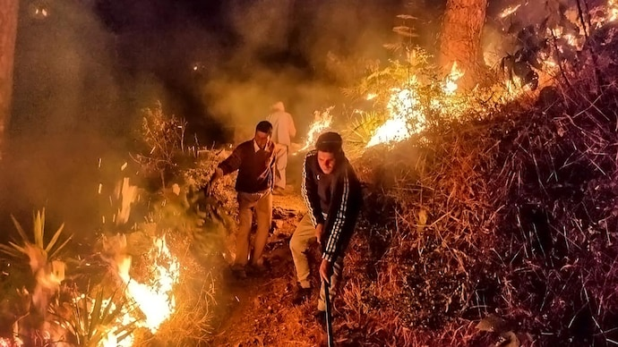
A PICTURE IS WORTH A THOUSAND WORDS

Slide 11
5,732
Number of forest fires in Uttarakhand since 2019
Hindustan Times

Slide 12
5,00,000 L
111.14 km
5 Lakh Liters of water used to douse 132 wildfires
Times Of India
Area of forest-fire since 2019
Hindustan Times

Slide 13
Higher the Humidity Lower the Probability
25%
50%
75%+
High chances of Wildfire
Low Chances of Wildfire
No chances of wildfire

Slide 14
03
DEVELOPMENT

Slide 15
Development of Machine Learning Model
Input: Oxygen, Humidity, Temperature
Output: Probability of Fire Occurrence
Dataset: We start with a dataset of 100 values, which can be expanded as the project scope increases to achieve higher accuracy.
2.3 Learning Algorithm
This problem falls under the category of Supervised Learning. We train our machine learning model using the following three algorithms and compare their accuracies:
Linear Regression
Logistic Regression
Support Vector Machine (SVM)
Based on the highest accuracy obtained using the scikit-learn library in Python, we select the Logistic Regression model.

Slide 16
Logistic Regression
Logistic Regression is a machine learning model that outputs the probability of a particular input instance belonging to a specific class.
In this case, the output classes are 'Fire' (Forest fire likely to occur) and 'Not' (Forest fire unlikely to occur).
This allows us to prioritize areas based on the likelihood of a forest fire occurring.
Large Scale Application
With access to more data, the accuracy of the machine learning model can be further improved.
On a large scale, this model can be deployed by forest authorities to generate a prioritized list of areas with the highest likelihood of a fire.
This model can be integrated into a web application to provide an interface for authorities, enabling smarter patrolling of forests.

Slide 17
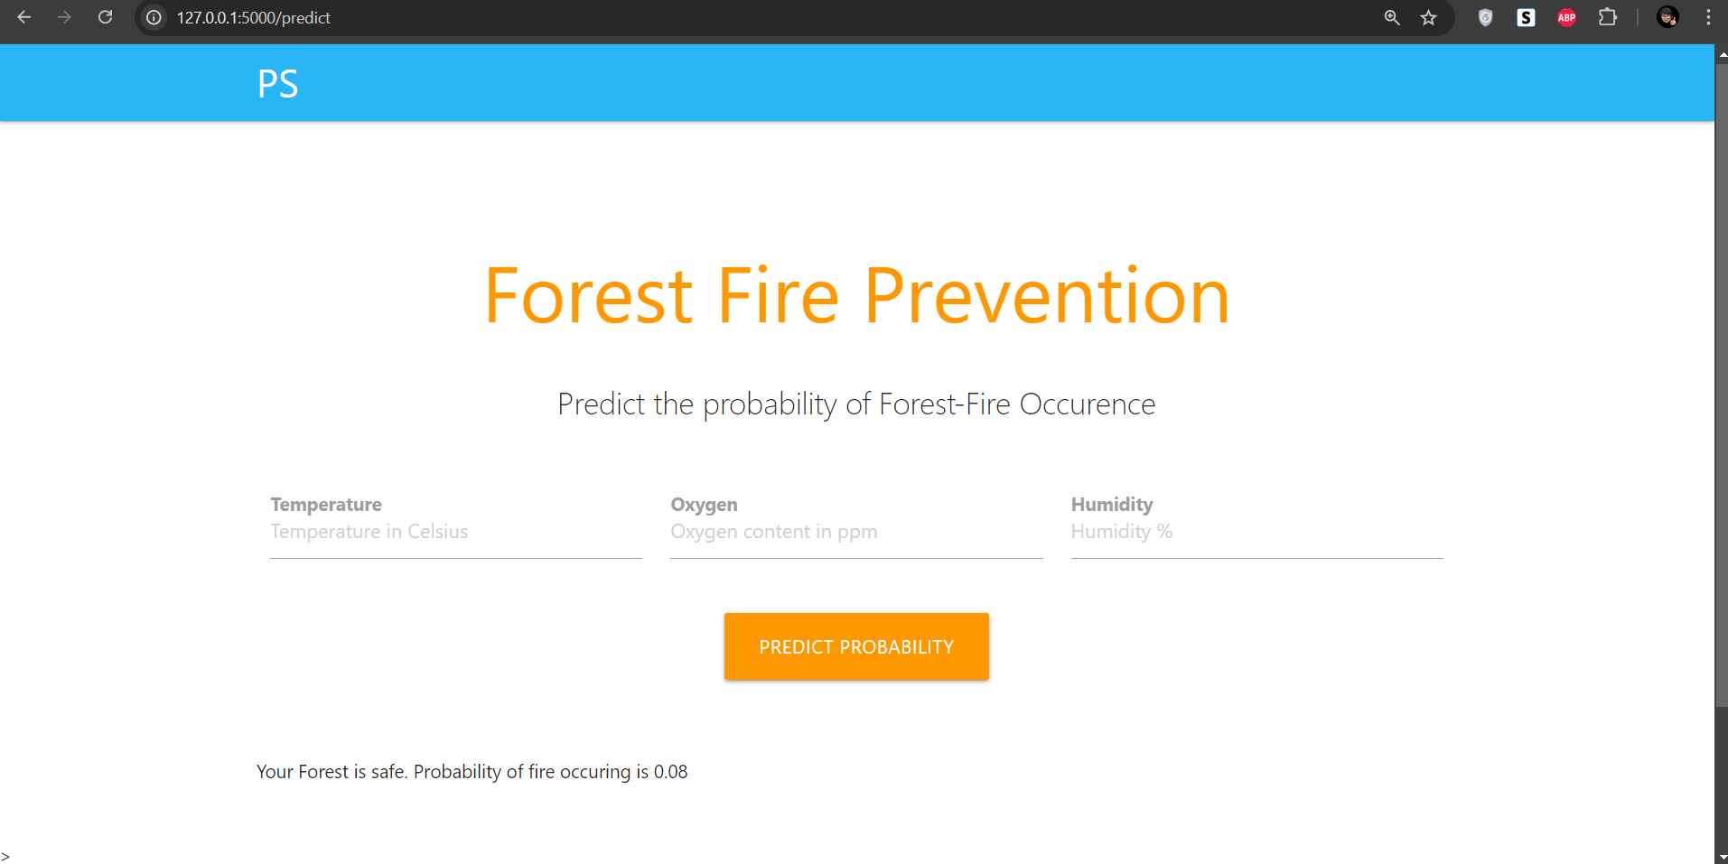
Web Application
When applied to web development, we can create an application that takes three inputs from the user to predict the forest fire probability.
This application can also be used by citizens, allowing them to patrol forests and alert authorities in case of danger.
Flask , Python as well as HTML,CSS are used for the development of the web application.

Slide 18
04
Future Versions

Slide 19
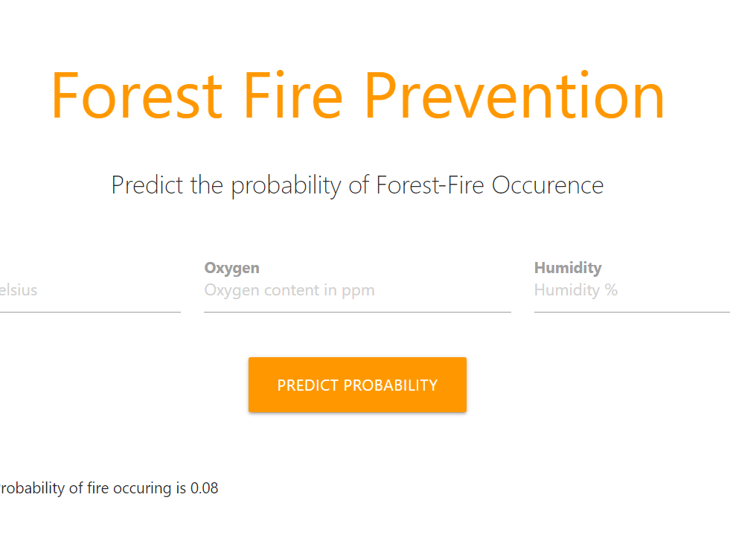
MOBILE /TABLET WEB
Future versions of this system will include dedicated mobile apps to further enhance accessibility and usability. Until then, the current web application is designed to work seamlessly on both mobile devices and tablets, ensuring that users can monitor and predict forest fire risks on-the-go. This cross-platform compatibility ensures that authorities and citizens alike can access vital information whenever and wherever they need it.

Slide 20
CAUSES OF DESTRUCTIVE WILDFIRES
POWER-LINES
Future versions
HUMAN RELATED
Data Set from all these will be implemented in the Future Versions.
ELECTRICAL
ARSON
LIGHTNING
1
2
3
4
5
6
7

Slide 21
SAFE IN SMOKY CONDITIONS
Future Versions to support calling authorities and the nearby people to prevent injuries due to the wildfire.
STAY INSIDE
STAY HYDRATED
WEAR A MASK

Slide 22
CONCLUSION
Machine learning can significantly aid in predicting the possibility of a forest fire. By integrating this model with web or app development, it can be applied on a large scale to prevent and detect wildfires globally.

Slide 23
THANKS!
Do you have any questions?
pranshulsharma30@gmail.com
+91 7895199421

